Slide 1
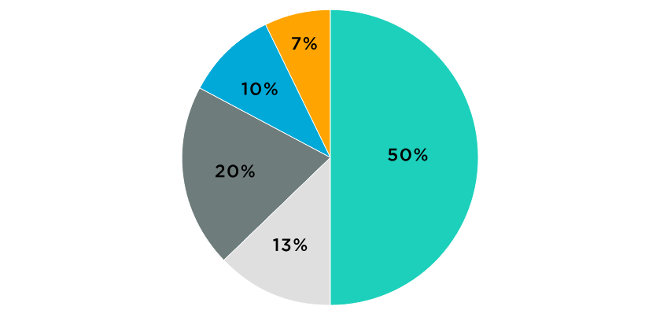
PIE CHART

Slide 2
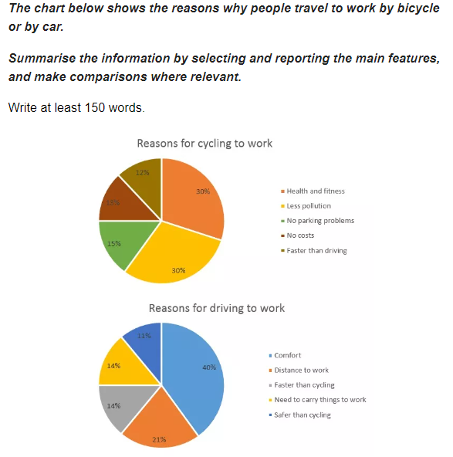
Pie Chart

Slide 3
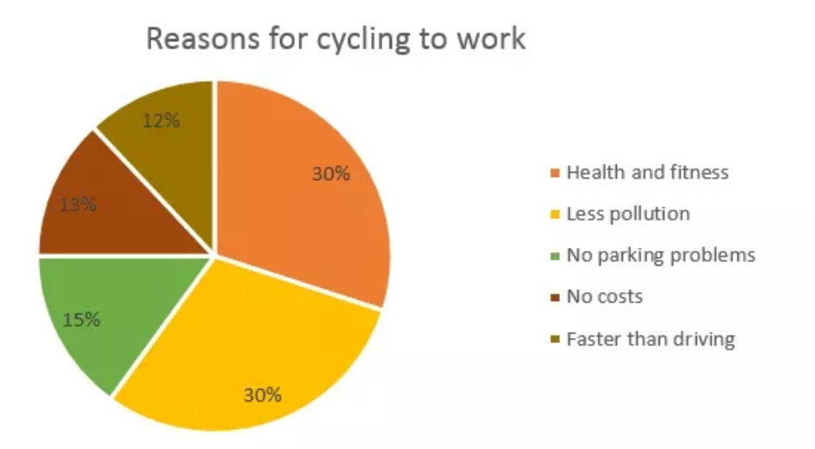
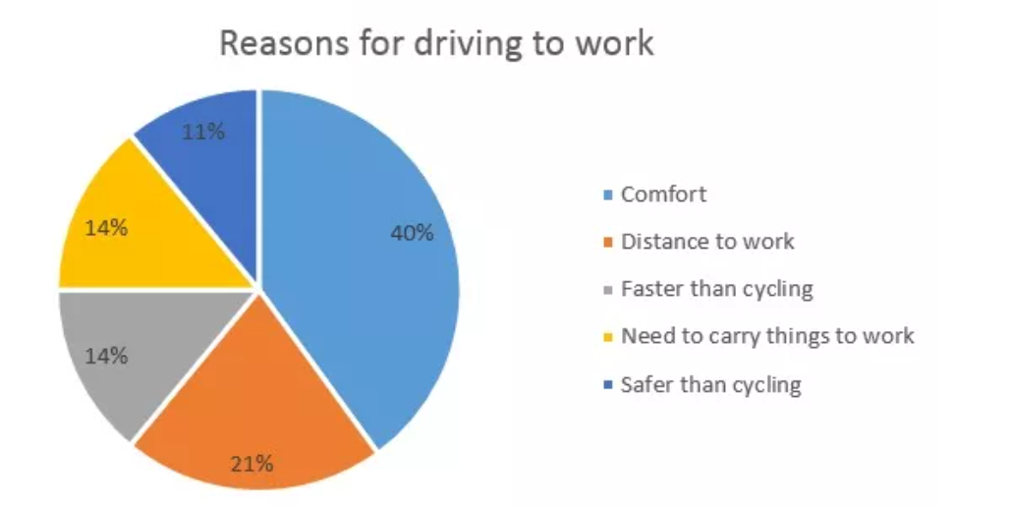
SAMPLE ANSWER
The two pie charts display the key reasons why people choose to either cycle or drive to work by percentage. The largest proportion of people who cycle, have made this choice for health and environmental reasons whilst the prime advantage of driving to work is considered to be the comfort of travelling by car. Notably, for an almost equal proportion of people, their chosen method is the fastest.
Taken together, health and fitness and less pollution are reasons given by over half of all people who prefer travelling by bike. Each represents a 30% portion which is double the next most popular reason which is a lack of parking issues at 15%.
A different set of concerns has affected the decision of those who choose to commute by car. Comfort is by far the most significant factor at 40% of people, but distance to work is a more important concern for just over a fifth of drivers. For 14% of people, a faster journey time is the key factor compared to a figure of 12% of cyclists who find their means of transport quicker.
(184 words)

Slide 4
BREAKDOWN AND EXPLANATION

Slide 5
Pie Chart
Before we begin, here’s a model structure that you can use as a guideline for all IELTS Academic Task 1 questions.
Ideally, your writing should have 3 paragraphs:
Paragraph 1 – Introduction+Overview
Paragraph 2 – 1st main feature
Paragraph 3 – 2nd main feature

Slide 6
Analyse the question
The chart shows the reasons why people travel to work by bicycle or by car.
Summarise the information by selecting and reporting the main features, and make comparisons where relevant.

Slide 7
The chart below shows the reasons why people travel to work by bicycle or by car.
Summarise the information by selecting and reporting the main features, and make comparisons where relevant.
Write at least 150 words.
Every question consists of:
Sentence 1 – A brief description of the graphic
Sentence 2 – The instructions
The graphic – chart, graph, table, etc.
Sentence 2 tells you what you have to do.
You must do 3 things:
1. Select the main features.
2. Write about the main features.
3. Compare the main features.

Slide 8
Identify the Main Features
What can you learn from the title and any labels?
What is the most obvious trend?
Are there any notable similarities?

Slide 9
Identify the Main Features
Main feature 1: The largest proportion of people who cycle do so for health and environmental reasons.
Main feature 2: The highest percentage of people who drive do so because it’s comfortable.

Slide 10
Write an Introduction
Question:
The chart below shows the reasons why people travel to work by bicycle or by car.
Introduction (Paragraph 1):
The two pie charts display the key reasons why people choose to either cycle or drive to work by percentage.
DO NOT GIVE ANY HEADING
THE HEADINGS OF THE PARAGRAPHS ARE FOR EXPLANATION ONLY
YOUR WRITING SHOULD ONLY HAVE PARAGRAPHS AS SHOWN IN THE LAST SLIDE

Slide 11
Write an Overview
Main feature 1: The largest proportion of people who cycle do so for health and environmental reasons.
Main feature 2: The highest percentage of people who drive do so because it’s comfortable.
Main feature 3: For an almost equal proportion of people, their chosen method is the fastest.
Overview (Paragraph 1):
The largest proportion of people who cycle, have made this choice for health and environmental reasons whilst the prime advantage of driving to work is considered to be the comfort of travelling by car. Notably, for an almost equal proportion of people, their chosen method is the fastest.
DO NOT GIVE ANY HEADING
THE HEADINGS OF THE PARAGRAPHS ARE FOR EXPLANATION ONLY
YOUR WRITING SHOULD ONLY HAVE PARAGRAPHS AS SHOWN IN THE LAST SLIDE

Slide 12
Paragraph-1 (Intro+Overview)
The two pie charts display the key reasons why people choose to either cycle or drive to work by percentage. The largest proportion of people who cycle, have made this choice for health and environmental reasons whilst the prime advantage of driving to work is considered to be the comfort of travelling by car. Notably, for an almost equal proportion of people, their chosen method is the fastest.
DO NOT GIVE ANY HEADING
THE HEADINGS OF THE PARAGRAPHS ARE FOR EXPLANATION ONLY
YOUR WRITING SHOULD ONLY HAVE PARAGRAPHS AS SHOWN IN THE LAST SLIDE

Slide 13
Write the 1st Detail Paragraph
Main feature 1: The largest proportion of people who cycle do so for health and environmental reasons.
Paragraph 2:
Taken together, health and fitness and less pollution are reasons given by over half of all people who prefer travelling by bike. Each represents a 30% portion which is double the next most popular reason which is a lack of parking issues at 15%.
DO NOT GIVE ANY HEADING
THE HEADINGS OF THE PARAGRAPHS ARE FOR EXPLANATION ONLY
YOUR WRITING SHOULD ONLY HAVE PARAGRAPHS AS SHOWN IN THE LAST SLIDE

Slide 14
Write the 2nd Detail Paragraph
Main feature 2: The highest percentage of people who drive do so because it’s comfortable.
Main feature 3: For an almost equal proportion of people, their chosen method is the fastest.
Paragraph 3:
A different set of concerns has affected the decision of those who choose to commute by car. Comfort is by far the most significant factor at 40% of people, but distance to work is a more important concern for just over a fifth of drivers. For 14% of people, a faster journey time is the key factor compared to a figure of 12% of cyclists who find their means of transport quicker.
DO NOT GIVE ANY HEADING
THE HEADINGS OF THE PARAGRAPHS ARE FOR EXPLANATION ONLY
YOUR WRITING SHOULD ONLY HAVE PARAGRAPHS AS SHOWN IN THE LAST SLIDE

Slide 15
SAMPLE ANSWER
The two pie charts display the key reasons why people choose to either cycle or drive to work by percentage. The largest proportion of people who cycle, have made this choice for health and environmental reasons whilst the prime advantage of driving to work is considered to be the comfort of travelling by car. Notably, for an almost equal proportion of people, their chosen method is the fastest.
Taken together, health and fitness and less pollution are reasons given by over half of all people who prefer travelling by bike. Each represents a 30% portion which is double the next most popular reason which is a lack of parking issues at 15%.
A different set of concerns has affected the decision of those who choose to commute by car. Comfort is by far the most significant factor at 40% of people, but distance to work is a more important concern for just over a fifth of drivers. For 14% of people, a faster journey time is the key factor compared to a figure of 12% of cyclists who find their means of transport quicker.
(184 words)

